Slide 1

Amp Up Your Presentations or How to Avoid PowerPoint Heck

Slide 2

In Time Tec
Let’s meet for coffee or lunch.
Joel Robinson
JoelHRobinson @ Gmail.com
208-602 8478

Slide 3
Meeting Agenda
Start Memory Game
Soft Skills
Planning Skills
PowerPoint

Slide 4
David Phillips How to Avoid Death by Powerpoint 90% what you say is forgotten in 30 seconds.
People look at boarding pass multiple times… five, seven, ten times. I chant the numbers to myself.

Slide 5
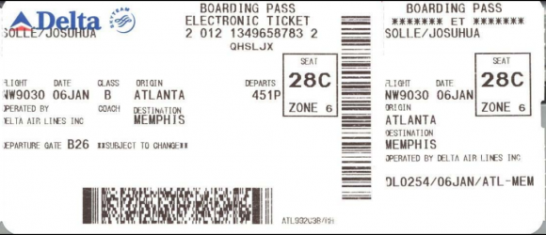
“Airport Game”

Slide 6


Soft Skills
Practice Speaking
Get Feedback

Slide 7
Enthusiasm!
Loud Enough!
Vocal Variety!

Slide 8
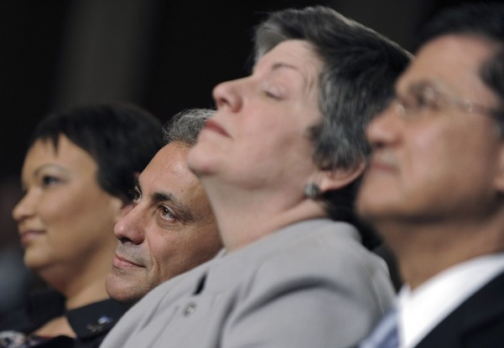
If they fall asleep… or their eyes glaze over… it’s possibly your fault.

Slide 9
What’s your goal? Have a plan !

Slide 10
Questions?
When do you take questions?
1-way or interactive

Slide 11
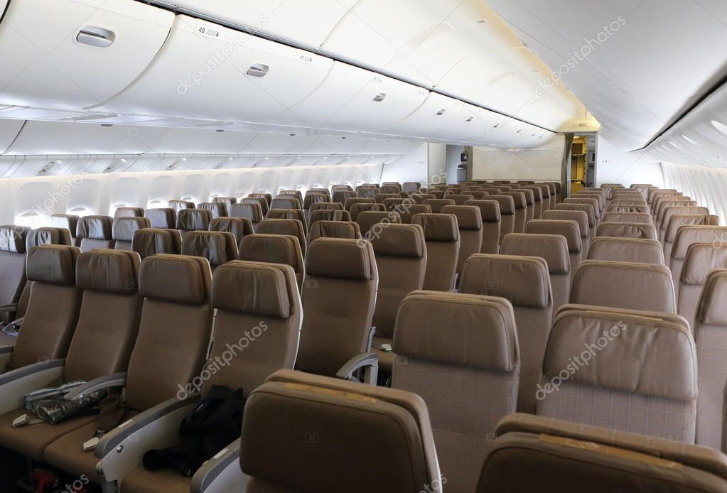
Game: Seat Number

Slide 12
Late arrivals Expect Late Arrivals

Slide 13
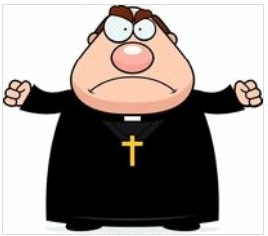
You can’t start the wedding without the couple.
No matter how mad you are,
No matter how late they are,

Slide 14
MITIGATE TARDINESS
Decide who is essential.
Pre-confirm time / place.
Start off-peak e.g. 10:05 AM.

Slide 15
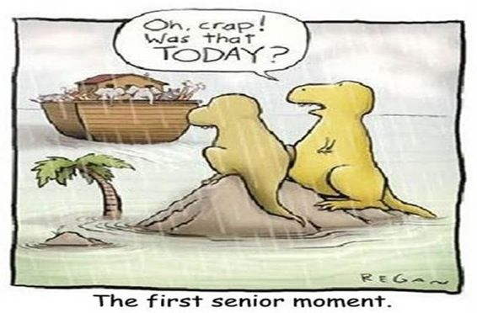

Slide 16
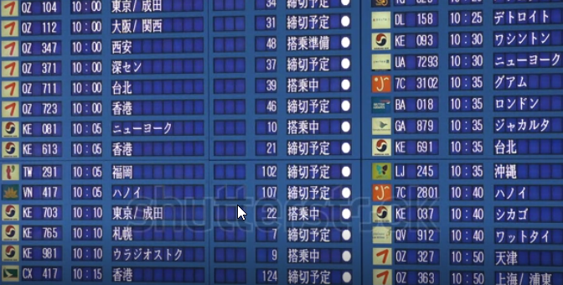
Game: Destination City

Slide 17

Day of Meeting

Slide 18
Be prepared
Know your material
COLD!

Slide 19
Be prepared
Get there early
Set up early
Log in early

Slide 20
HW Gear Bag
USB drive with presentation
Mouse & battery
Spare video cables
Power cord
Presentation clicker / laser

Slide 21
SW Checklist
Update & charge laptop
Reboot before the dry run
Get Internet password

Slide 22

Greet attendees as they arrive

Slide 23
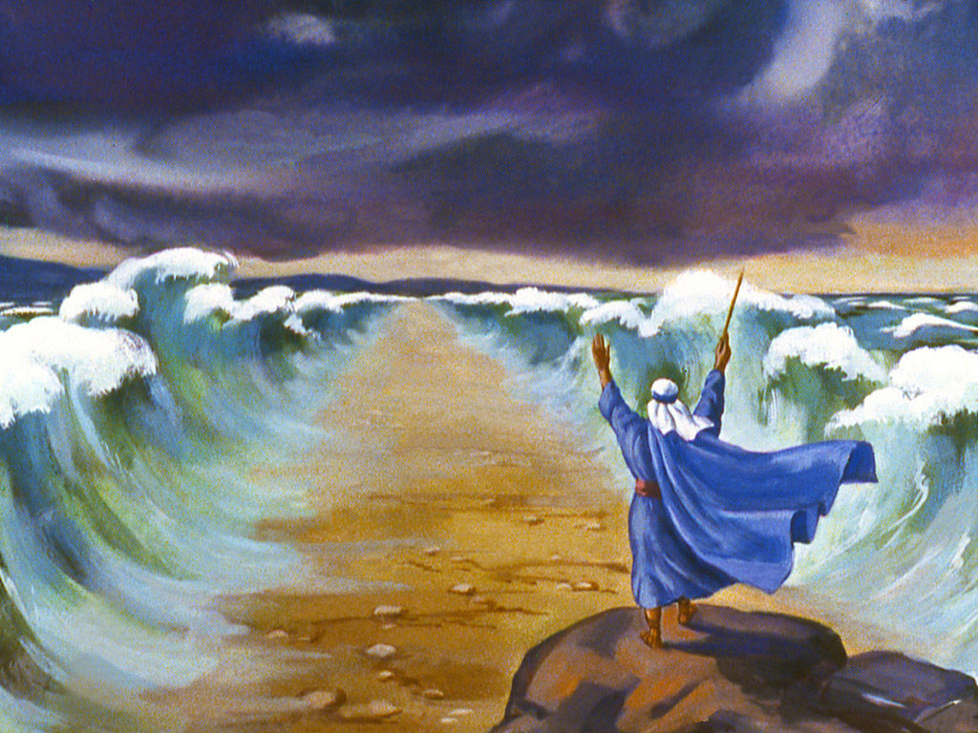
Begin The PowerPoint

Slide 24
One Main Idea per slide

Slide 25
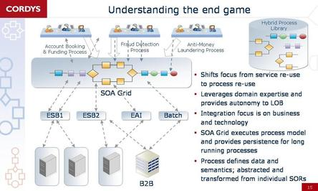

Slide 26
What was their “end game?”
Can you possibly remember
ANY of that slide?

Slide 27
Your slide could become world-famous bad, even make the front page of the New York Times!

Slide 28
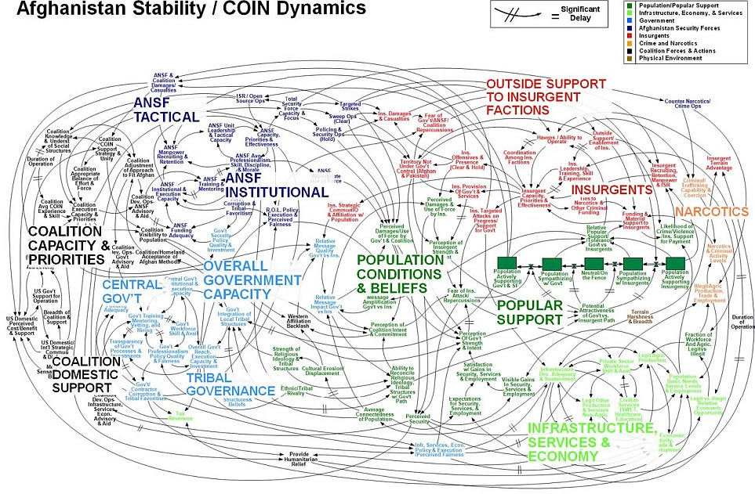

Slide 29
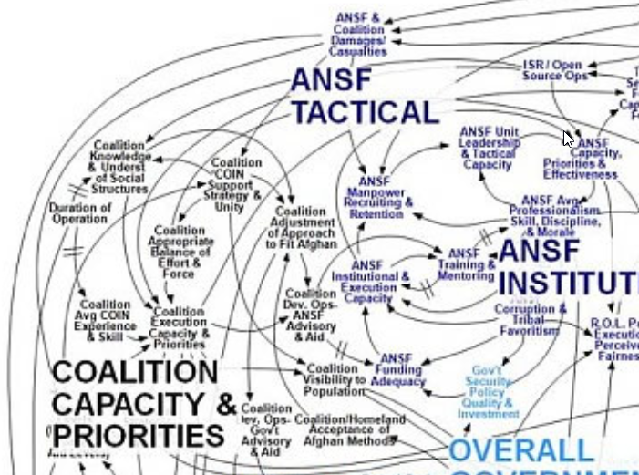

Slide 30
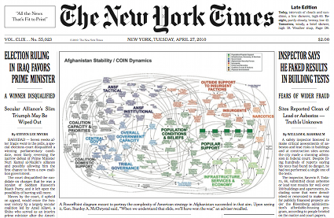

Slide 31
General McCrystal:
When we understand that slide,
We’ll have won the war.

Slide 32
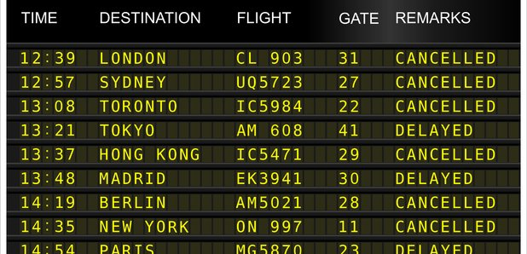
Game: Seat # + Flight #

Slide 33
Size Matters
Fonts that is.

Slide 34
72 point Calibri
60 point Calibri
44 point Calibri
40 point Calibri
32 point Calibri
24 point Calibri
18 point Calibri

Slide 35
Pick a Font Stick with it
Calibri
Tahoma
Verdana

Slide 36
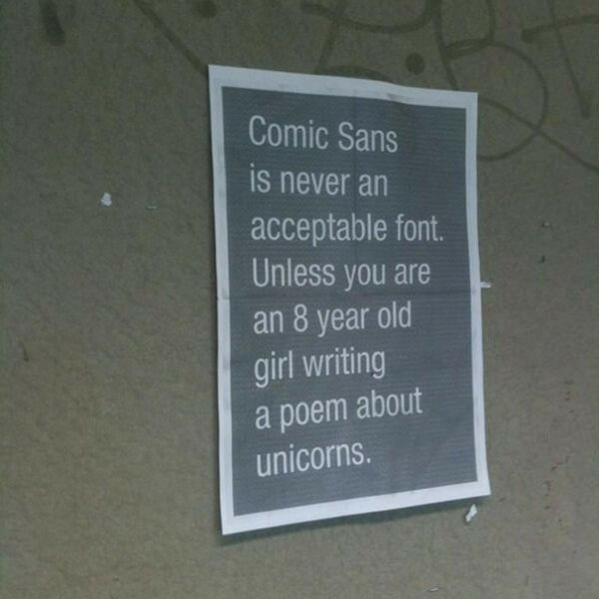

Slide 37
Backgrounds:
Simple Dark backgrounds
Light / white letters

Slide 38
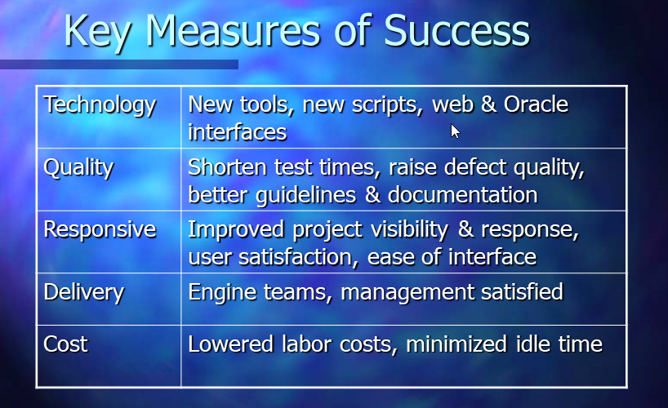
Not This

Slide 39
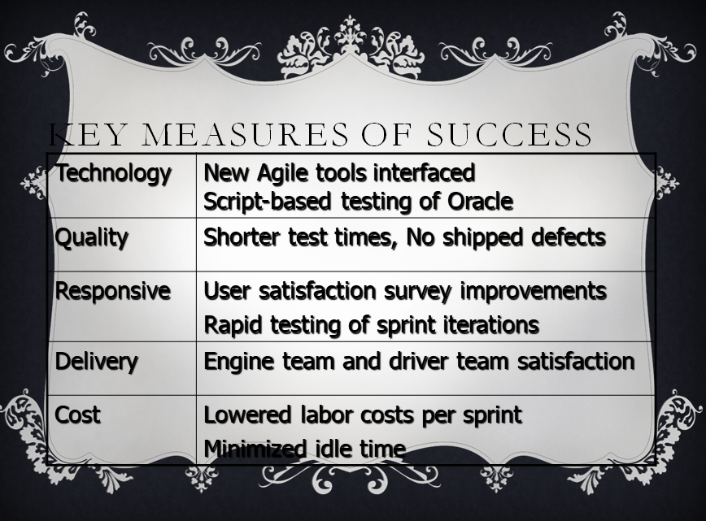
Not this either

Slide 40
Where is your eye focused?
Technology | New Agile tools interfaced Script-based testing of Oracle
Quality | No shipped defects
Responsive | User satisfaction survey improvements Rapid testing of sprint iterations
Delivery | Firmware and driver team schedules
Cost | Lowered labor costs per sprint Minimized idle time

Slide 41
Highlight Rows
Technology | New Agile tools interfaced Script-based testing of Oracle
Quality | No shipped defects
Response Time | User satisfaction survey improvements Rapid testing of sprint iterations
Delivery | Engine team and driver team satisfaction
Cost | Lowered labor costs per sprint Minimized idle time

Slide 42
Technology | New Agile tools interfaced Script-based testing of Oracle
Quality | No shipped defects
Response time | User satisfaction survey improvements Rapid testing of sprint iterations
Delivery | Engine team and driver team satisfaction
Cost | Lowered labor costs per sprint Minimized idle time

Slide 43
Technology | New Agile tools interfaced Script-based testing of Oracle
Quality | Shorter test times, No shipped defects
Response Time | User satisfaction survey improvements Rapid testing of sprint iterations
Delivery | Engine team and driver team satisfaction
Cost | Lowered labor costs per sprint Minimized idle time

Slide 44
Fade other rows
Technology | New Agile tools interfaced Script-based testing of Oracle
Quality | No shipped defects
Response Time | User satisfaction survey improvements Rapid testing of sprint iterations
Delivery | Engine team and driver team satisfaction
Cost | Lowered labor costs per sprint, Minimized idle time

Slide 45
Focus with Fly-In:
First here: Discuss this factoid
Then here: Move on to this one
Then here: Keep up with it
Finally here: Whew! I’m done

Slide 46
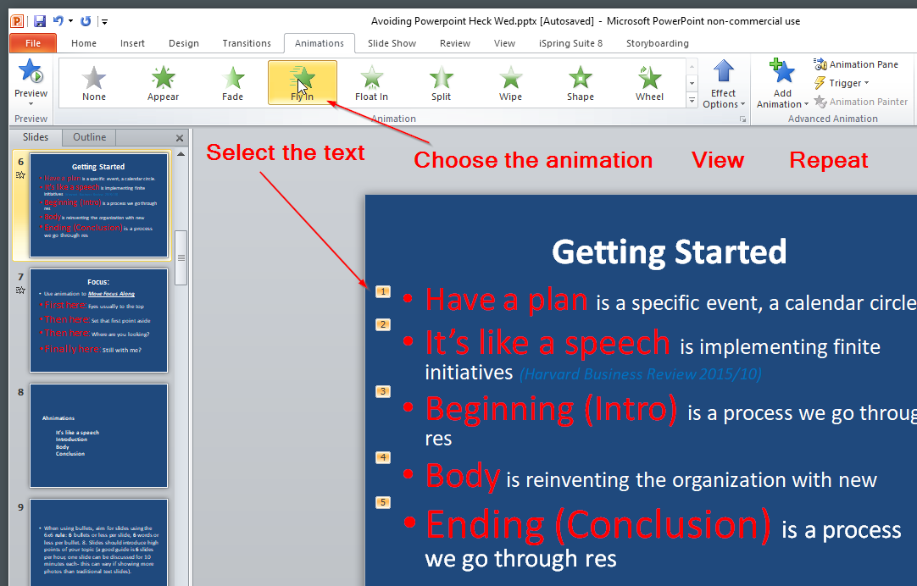

Slide 47
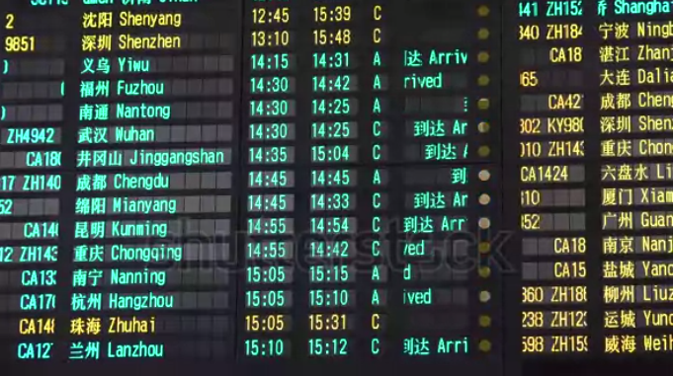
Game: Seat # + Flight # + Boarding Time

Slide 48
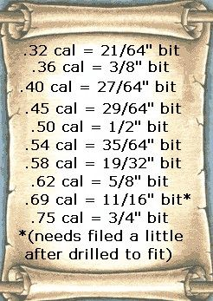

Bullet Rules

Slide 49
Bullet Rules
6 x 6 Rule
7 x 7 Rule
10/20/30 Rule
(Death by PowerPoint: David Phillips)

Slide 50
6 x 6 Rule for Bullets
6 bullets or less per slide.
6 words or less per bullet.
6 slides per hour, 10 minutes each slide
Can you imagine talking about this slide for 10 minutes? BORING!!!!

Slide 51
7 x 7 Rule
The 7x7 Rule states that a PowerPoint slide (or any other electronic slide) should have no more than
Seven lines of text and no more than
Seven words in each of those lines.

Slide 52
10 / 20 / 30 Rule
Guy Kawasaki said a PowerPoint presentation should have no more than Ten slides,
last no more than Twenty minutes,
and contain no font smaller than Thirty points.
Caveat: referring to venture capital presentations

Slide 53
Test: Count the white balls or bullet points as quickly as you can, and Shout out the number!

Slide 54
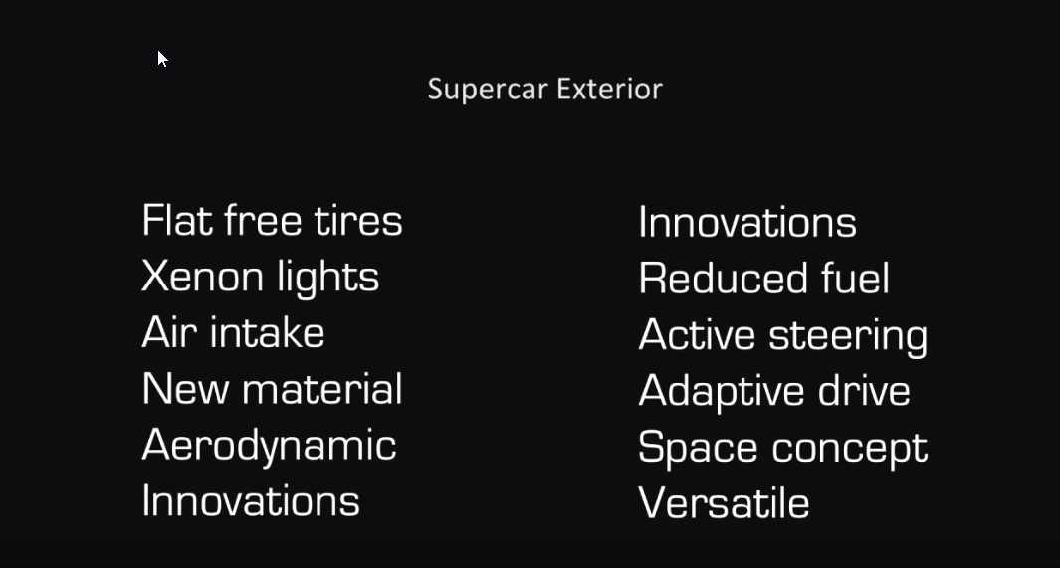

Slide 55


Slide 56


Slide 57


Slide 58
Seven maxes out what people can visually take in at one time. (Death by PowerPoint: David Phillips) Didn’t three feel easy on the eyes?

Slide 59
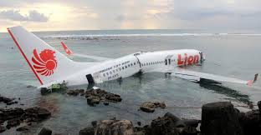
Game: Game: Seat # + Flight # + Boarding Time +
Arrival Time

Slide 60
Printing Slides
Focus is Diverted.
Must distribute & clean up
Never enough or have left overs
Latecomers want one
Online people are left out

Slide 61
Demo Videos
Embedded Videos:
Create the content, mind the size!
Online Videos:
Need Internet + Bandwidth

Slide 62
Active Links
https://www.bbc.com

Slide 63
Formats
*.MOV
Obsolete, need a new codex to play
*.WMV *.MP4
Rehearse on target computer / laptop

Slide 64
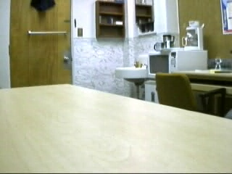


Slide 65
SOUND
You are just asking for trouble!

Slide 66
It’s not the number of slides that is important,
It’s the number of objects in your slides

Slide 67
Game: Seat #

Slide 68
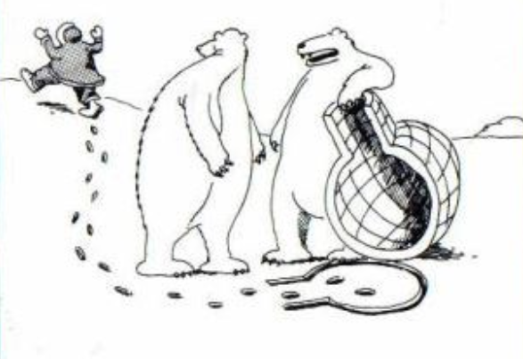
I lift, you grab. Was that concept just a little too complex, Carl?

Slide 69
Game Over: Discussion.

Slide 70
Let’s meet for coffee or lunch.
Joel Robinson
JoelHRobinson @ Gmail.com
208-602 8478

